Slide 1




ADULT CENSUS INCOME PREDICTION USING RANDOM FOREST
A Charan Sai
K Venkateswara
VM Udhay Kumar
K Vinay
A Mahesh
TEAM LEGACY

Slide 2
ABSTRACT:-
The prominent in equality of wealth and income is a huge concern especially in the United States. ... This study aims to show the usage of machine learning and data mining techniques in providing a solution to the income equality problem. The UCI Adult Dataset has been used for the purpose.
In this study Random Forest Classifier machine learning algorithm is applied to predict income levels of individuals based on attributes including age, education, marital status, gender, occupation, country and others. Income levels are defined as a binary variable income <=50K/year OR >=50K/year

Slide 3
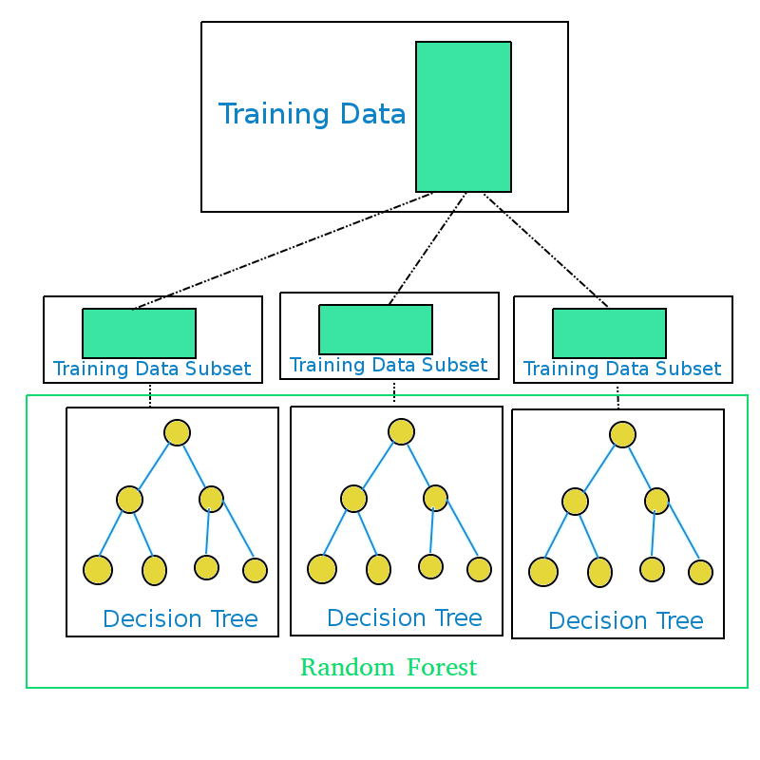
Model Explanation:
Random Forest Tree

Slide 4
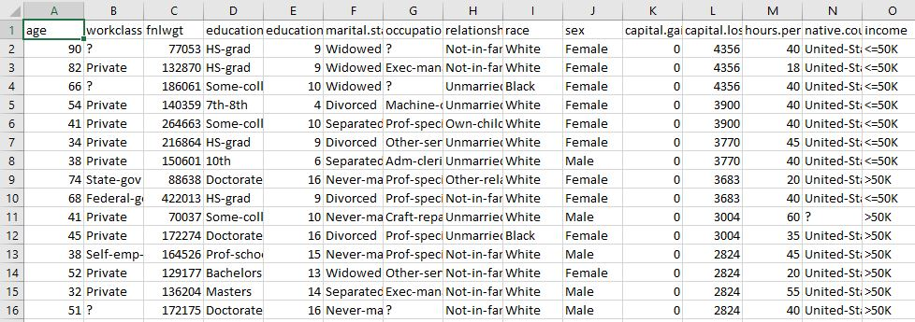
Data Explanation

Slide 5
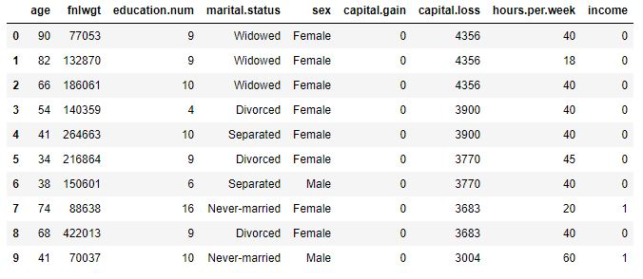
Converting categorical (text) values into dummy variables: most of the variables are categorical (text) except capital gain, capital loss, hours per
week, and years of education which are numeric. The categorical variables are transformed into dummy variables.
Dropping unnecessary columns: a variable containing information on the sample weight of the individuals is dropped from since it is not required for the analysis like work class, education, Occupation, race, native country.
Checking for null values and preparing separate features and target data frames: After doing all the above data cleaning steps, separates data frames for the feature and target data are generated.

Slide 6

Steps:
Collecting Data
Data Wrangling
Analysing Data
Train Algorithm
Test Algorithm
Deployment

Slide 7
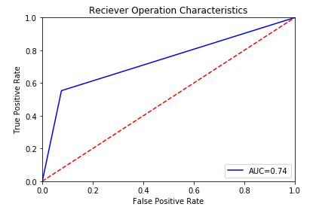
Fig: ROC Curve

Slide 8
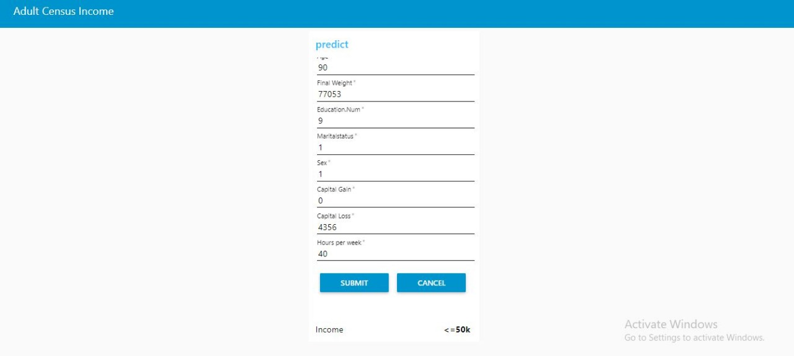
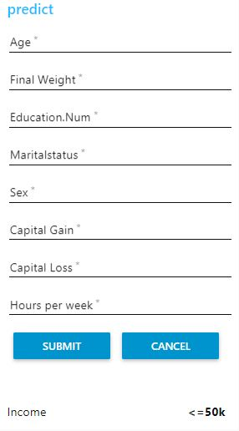
Example Prediction:
The Example prediction value of Adult census Income using Random Forest is as shown Below:
Fig: Without values
Fig: With values

Slide 9





Tools & Technologies
Anaconda Navigator:
is a desktop graphical user interface (GUI) included in Anaconda distribution.
Python is an interpreted, high-level, general-purpose programming language. Created by Guido van Rossum and first released in 1991.
The Jupyter Notebook is an open-source web application that allows you to create and share documents that contain live code, equations, visualizations and narrative text.
Node-RED provides a web browser-based flow editor, which can be used to create JavaScript function

Slide 10
Conclusion:
As we conclude that we use Adult Census income Prediction for predicting annual gross income of individuals of that country which helps in knowing development of that country.

Slide 11


